Slide 1

Module 0
Matrix / Tensor Algebra
Notes:
Guidelines
Use section headers to chunk content in your presentation.
Use the same style of section header throughout your presentation.
Keep your title to no more than 2 lines.

Slide 2
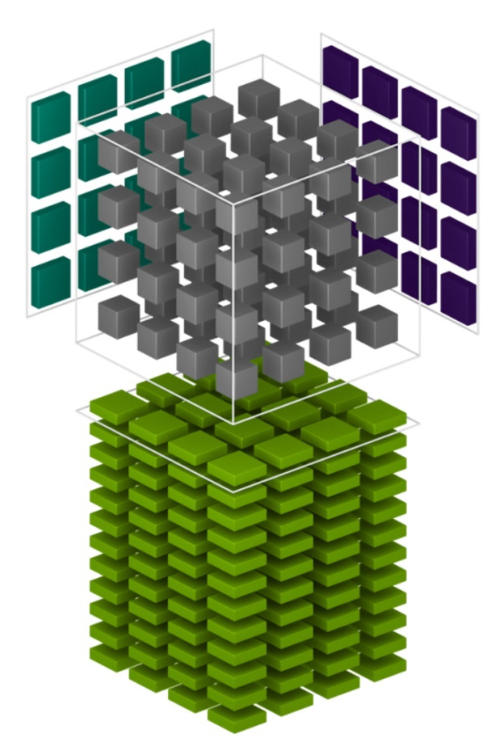
Matrices / Tensors
Notes:
Guidelines
Use a title slide at the beginning of your presentation. There are 9 variations of title slides to choose from.
If you will have a series of slideshows, we recommend using the same style of title slide for each presentation.
Keep your title to no more than 2 lines.
Do not change the font style or font size of the title or subtitle.

Slide 3
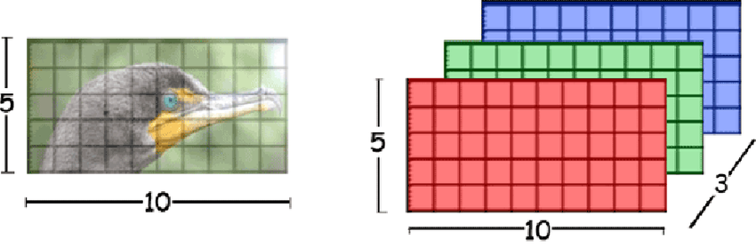
Data Vectors, Matrices, Tensors

Slide 4
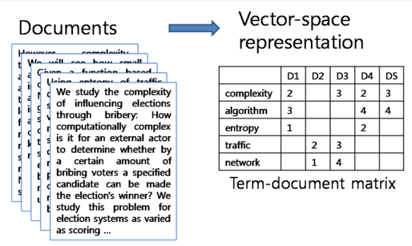
Data Vectors, Matrices, Tensors

Slide 5
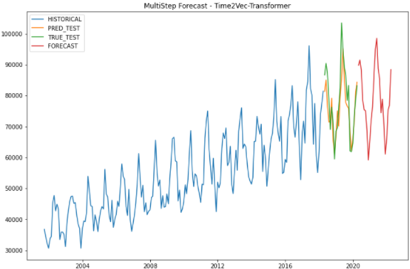
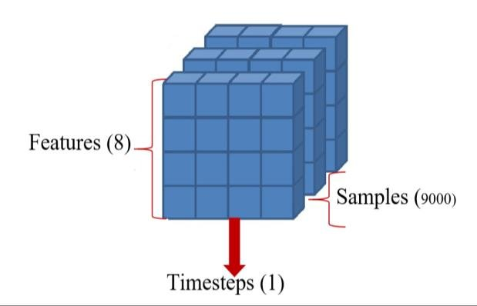
Data Vectors, Matrices, Tensors

Slide 6


NumPy vs Tensorflow
NumPy provides support for large multidimensional arrays (vectors), matrices and tensors.
Tensorflow also provides support for large multidimensional arrays (vectors), matrices and tensors. Has the ability to deploy numerical manipulations to run on CPUs, GPUs.

Slide 7
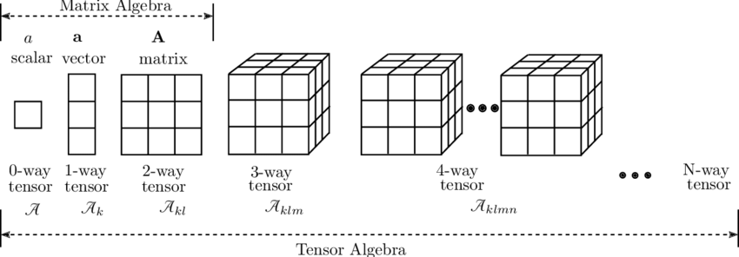
Linear Algebra
study of vectors / multidimensional arrays and certain algebra rules to manipulate them.

Slide 8
Vectors
A vector is an object that has both a magnitude and a direction. In mathematics and physics, vector is a term that refers to some quantities that cannot be expressed by a single number (a scalar).

Slide 9

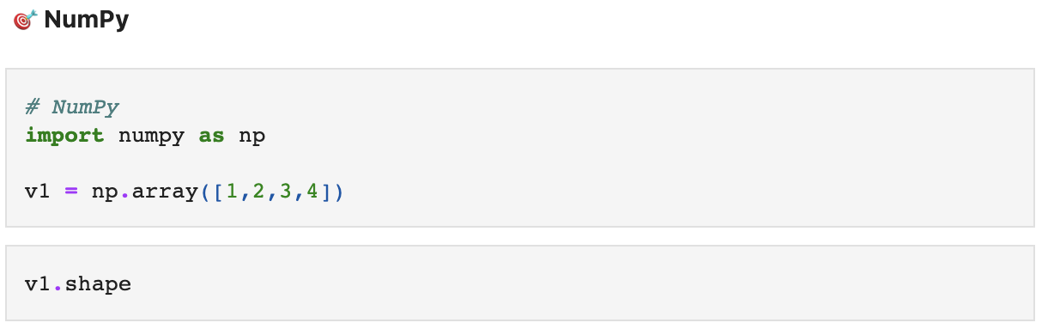
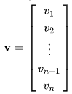
Vectors
A vector is an object that has both a magnitude and a direction. In mathematics and physics, vector is a term that refers to some quantities that cannot be expressed by a single number (a scalar).

Slide 10
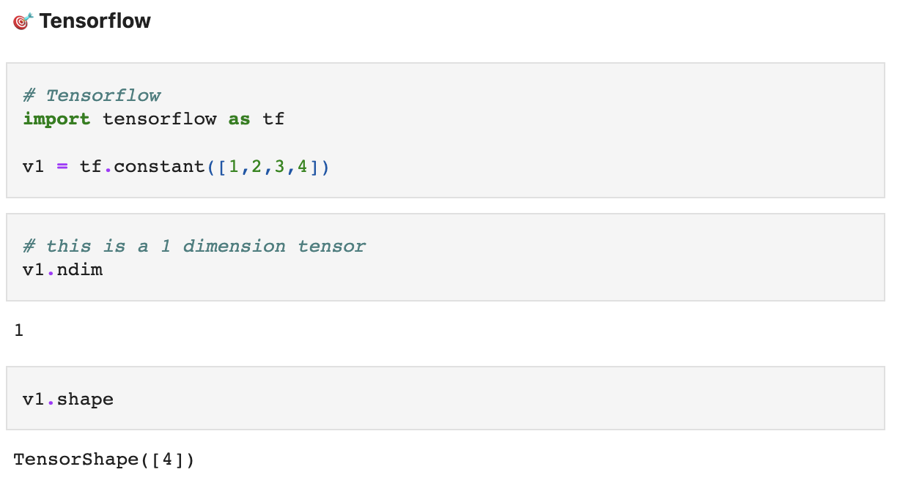
Vectors
A vector is an object that has both a magnitude and a direction. In mathematics and physics, vector is a term that refers to some quantities that cannot be expressed by a single number (a scalar).

Slide 11
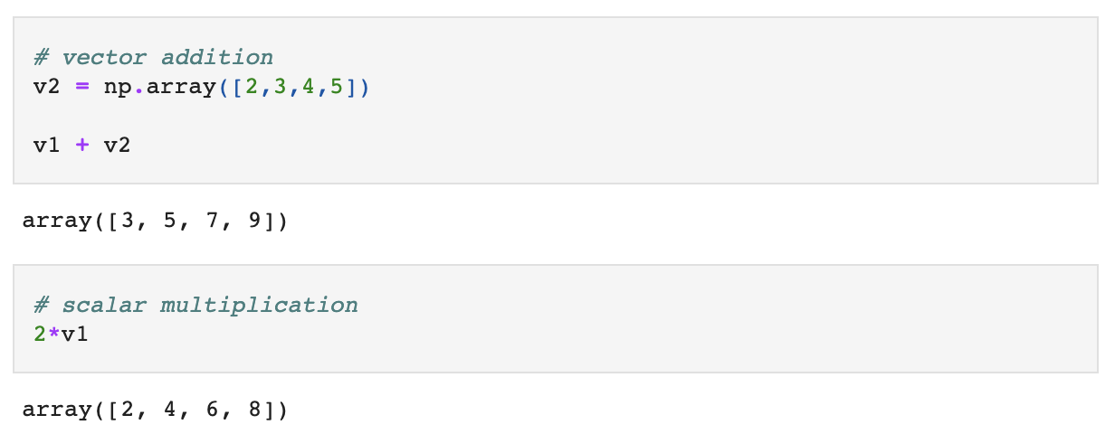
Vectors
Adding vectors means adding the individual elements.
Multiplying vectors by scalars means multiplying each element by scalar

Slide 12
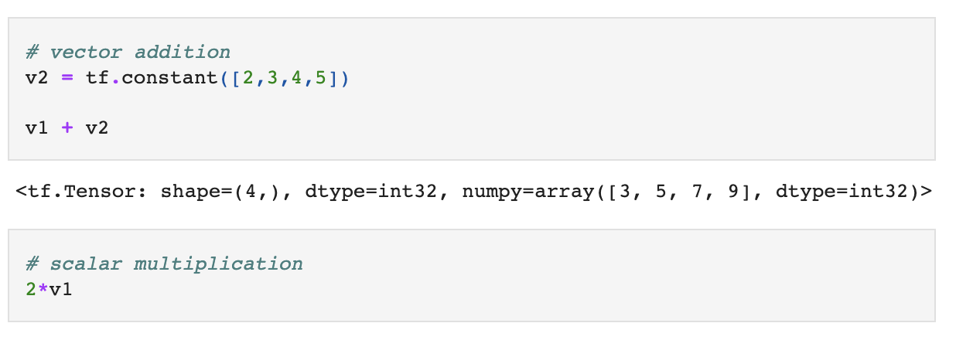
Vectors
Adding vectors means adding the individual elements.
Multiplying vectors by scalars means multiplying each element by scalar

Slide 13
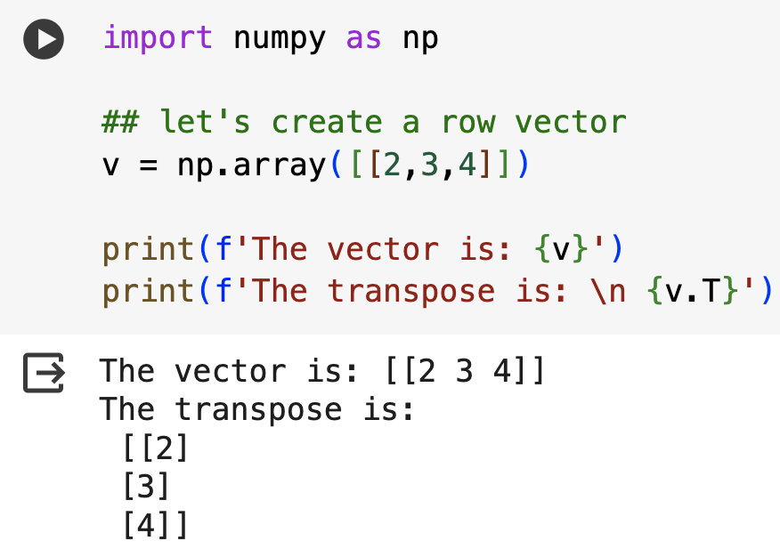
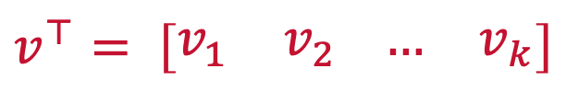
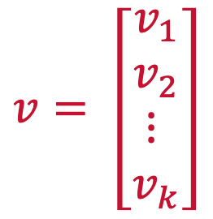
Vectors
The transpose of a vector changes a column vector to a row vector or vice versa.
$$v= \left[\begin{matrix}v_{1} \\ v_{2} \\ ⋮ \\ v_{k}\end{matrix}\right]$$
$$v^{⊤}= \left[\begin{matrix}v_{1} & v_{2} \end{matrix}\begin{matrix}… & v_{k}\end{matrix}\right]$$

Slide 14
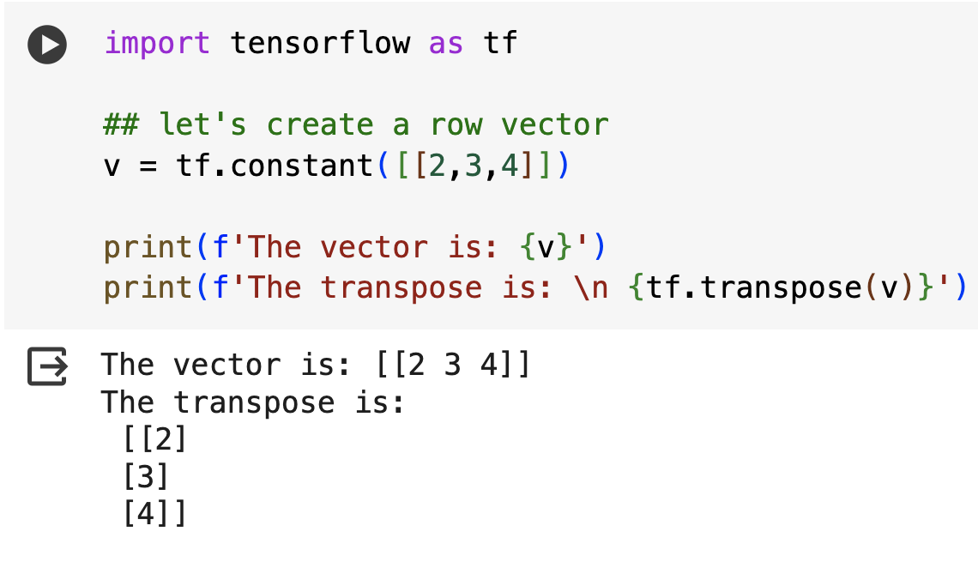
Vectors
The transpose of a vector changes a column vector to a row vector or vice versa.
$$v= \left[\begin{matrix}v_{1} \\ v_{2} \\ ⋮ \\ v_{k}\end{matrix}\right]$$
$$v^{⊤}= \left[\begin{matrix}v_{1} & v_{2} \end{matrix}\begin{matrix}… & v_{k}\end{matrix}\right]$$

Slide 15
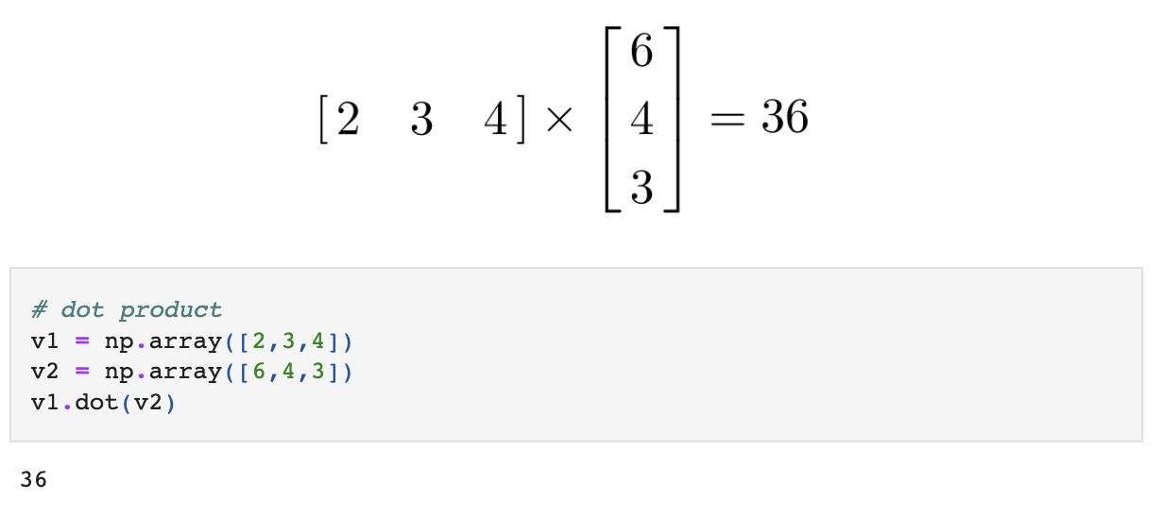
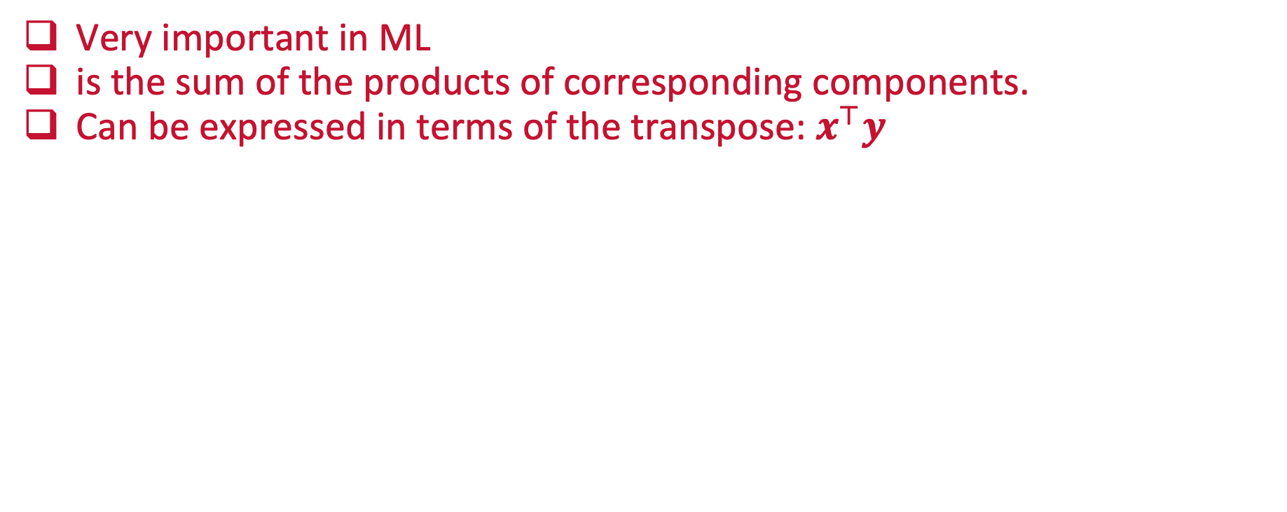
The Dot Product
Very important in ML
is the sum of the products of corresponding components.
Can be expressed in terms of the transpose: $x^{⊤}y$

Slide 16
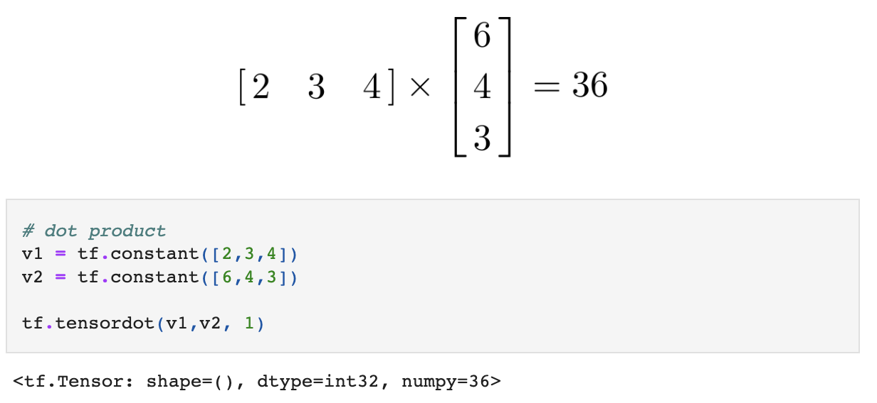
The Dot Product
Very important in ML
is the sum of the products of corresponding components.

Slide 17
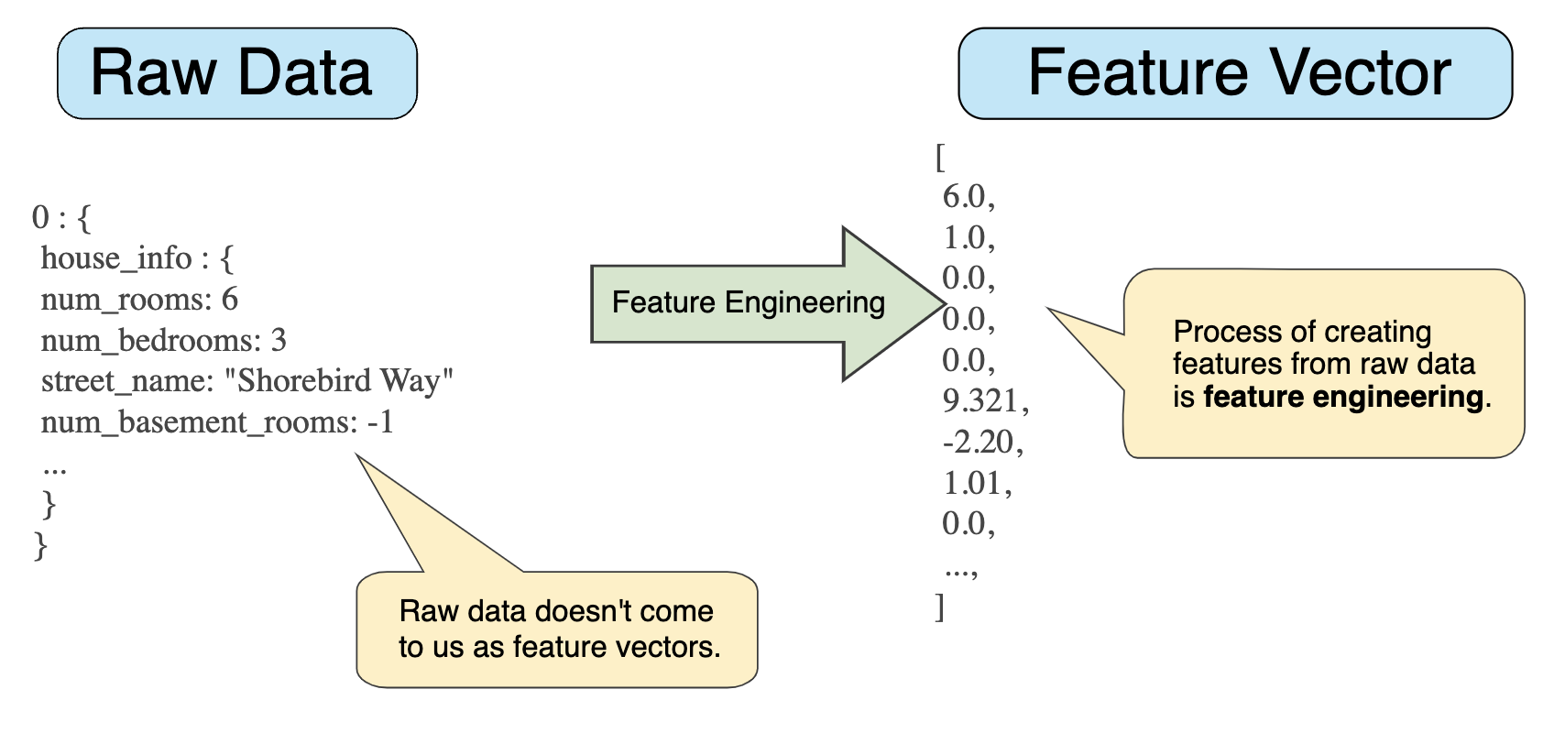
How Are Vectors used in ML?
The target variable is encoded as a numeric vector.
The weights (parameters) estimated are generally num. vectors.
Individual variables are num. vectors

Slide 18
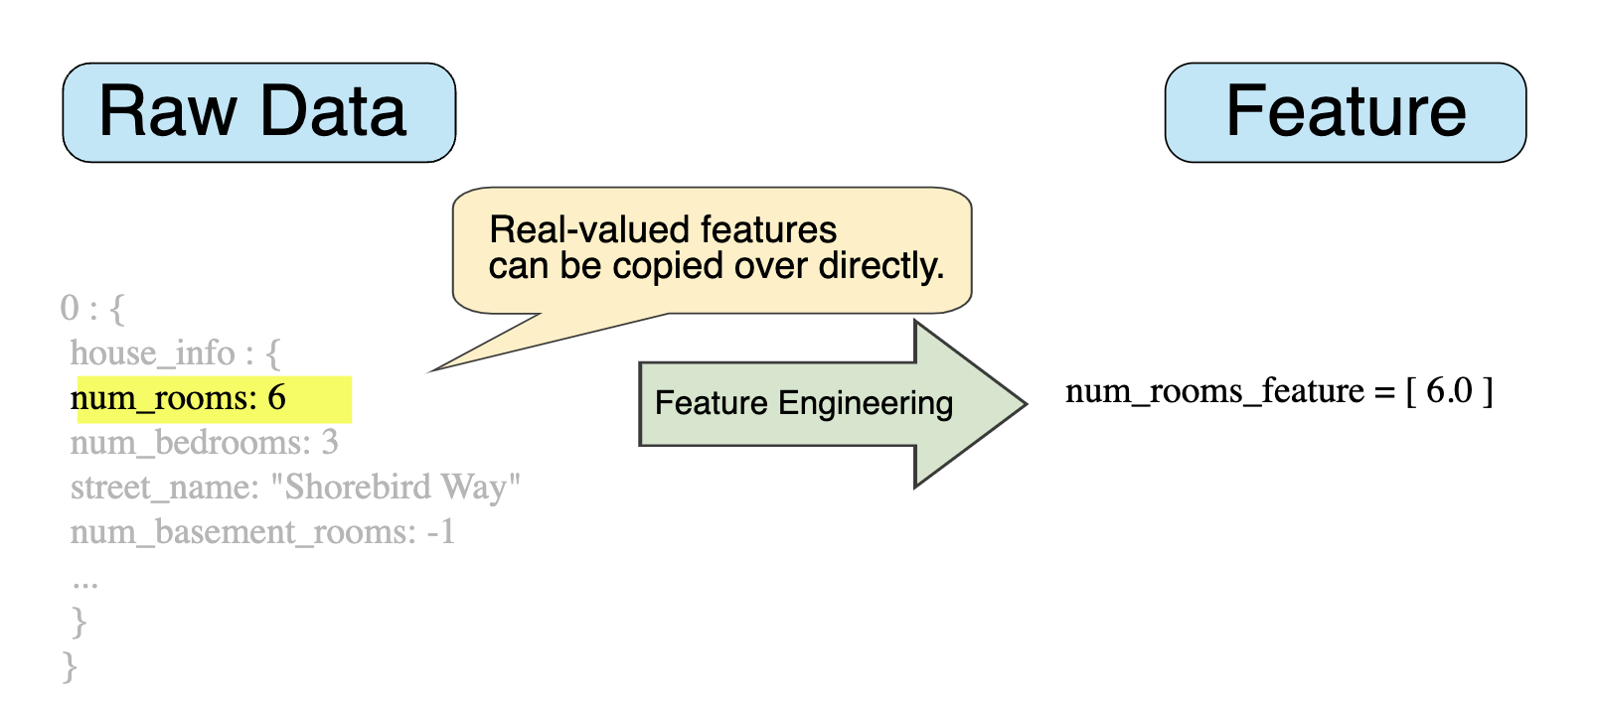
How Are Vectors used in ML?
The target variable is encoded as a numeric vector.
The weights (parameters) estimated are generally num. vectors.
Individual variables are num. vectors

Slide 19
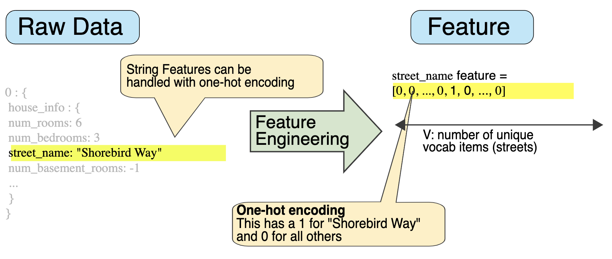
How Are Vectors used in ML?
The target variable is encoded as a numeric vector.
The weights (parameters) estimated are generally num. vectors.
Individual variables are num. vectors

Slide 20
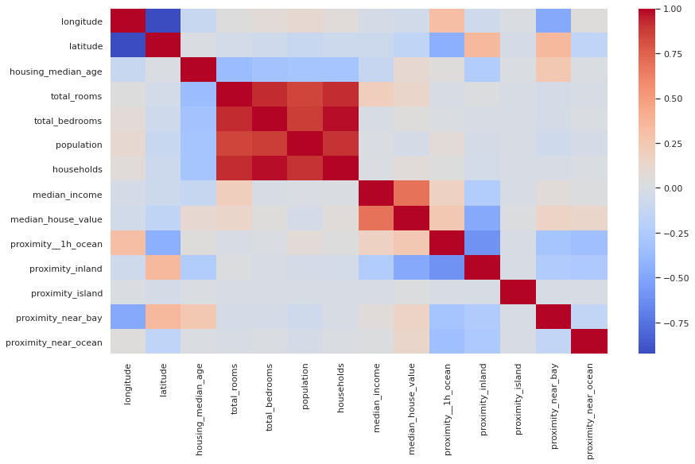
Example
Let’s think about the prediction of home values:

Slide 21
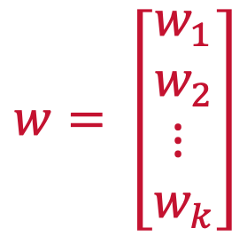
Vector Norms
Used in ML to regularize (drop insignificant relationships) weights.
$$w= \left[\begin{matrix}w_{1} \\ w_{2} \\ ⋮ \\ w_{k}\end{matrix}\right]$$
Goal is to zero out or diminish weights for insignificant variables

Slide 22
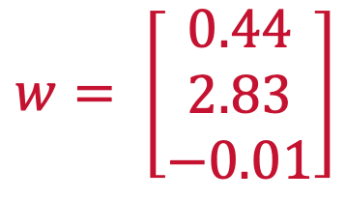
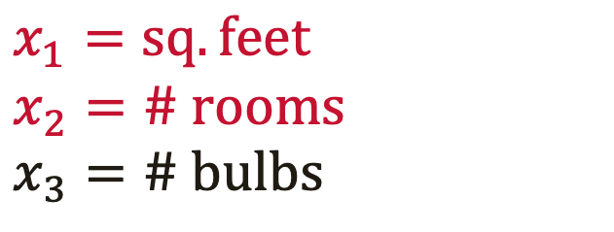
Vector Norms
Used in ML to regularize (drop insignificant relationships) weights.
$$w= \left[\begin{matrix}0.44 \\ 2.83 \\ −0.01\end{matrix}\right]$$
$$x_{1}=sq. feet$$
$$x_{2}=\# rooms$$
$$x_{3}=\# bulbs$$
We want this weight to be 0

Slide 23
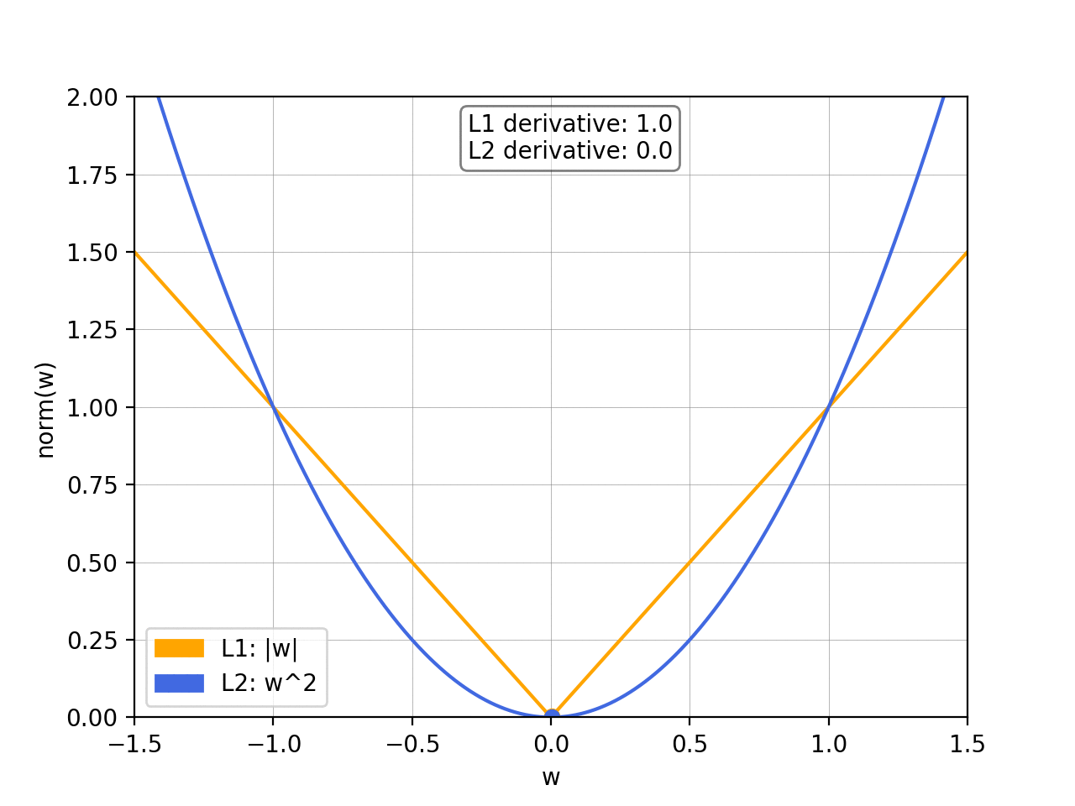
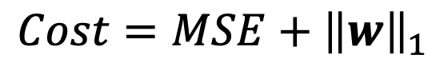
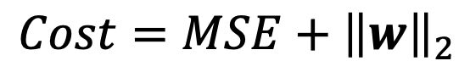
Vector Norms
Are added to cost functions as penalties (e.g., SSE, MSE)
The L₁ norm (tends to zero out the unimportant weights).
The L₂ norm (tends to to get the weights to be close to zero).
$$Cost=MSE+{\left\|w\right\|}_{2}$$
$$Cost=MSE+{\left\|w\right\|}_{1}$$

Slide 24
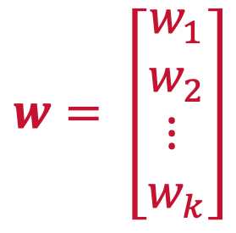

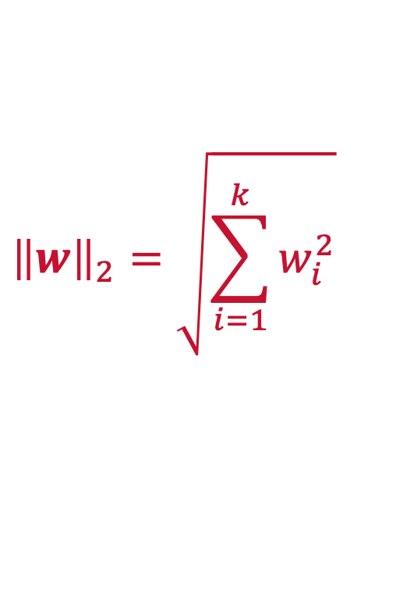
L₂ Norm
Tends to make weights close to zero
For a weight vector:
The L2 norm is defined as:
$$w= \left[\begin{matrix}w_{1} \\ w_{2} \\ ⋮ \\ w_{k}\end{matrix}\right]$$
$${\left\|w\right\|}_{2}=\sqrt{\sum_{i=1}^{k}{w_{i}^{2}}}$$
$${\left\|w\right\|}_{2}=\sqrt{w^{⊤}w}$$

Slide 25
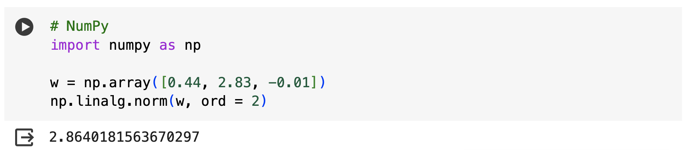

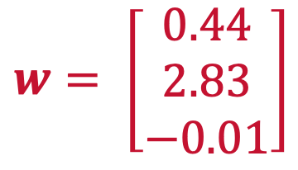
L₂ Norm
$$w= \left[\begin{matrix}0.44 \\ 2.83 \\ −0.01\end{matrix}\right]$$
$${\left\|w\right\|}_{2}=\sqrt{w^{⊤}w}$$

Slide 26
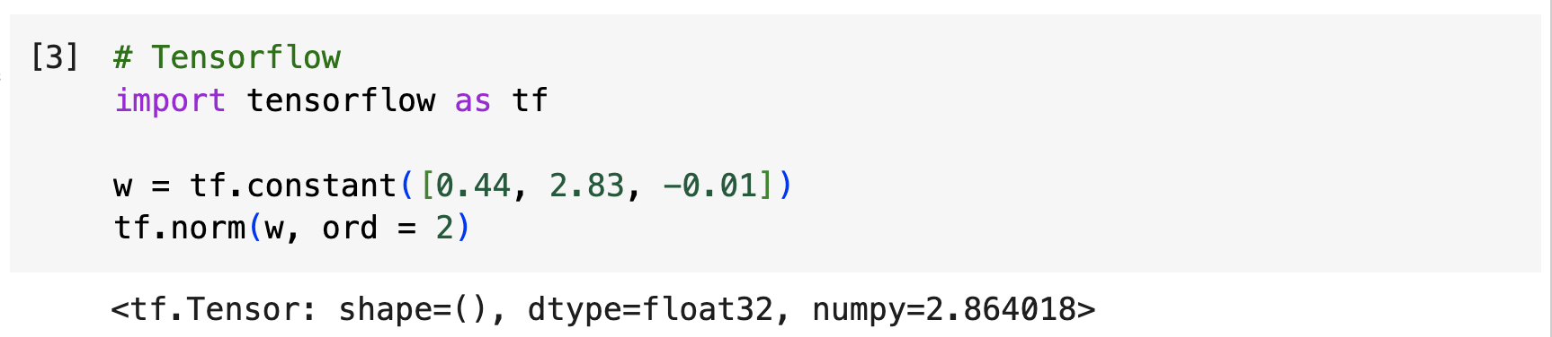
L₂ Norm
$$w= \left[\begin{matrix}0.44 \\ 2.83 \\ −0.01\end{matrix}\right]$$
$${\left\|w\right\|}_{2}=\sqrt{w^{⊤}w}$$

Slide 27
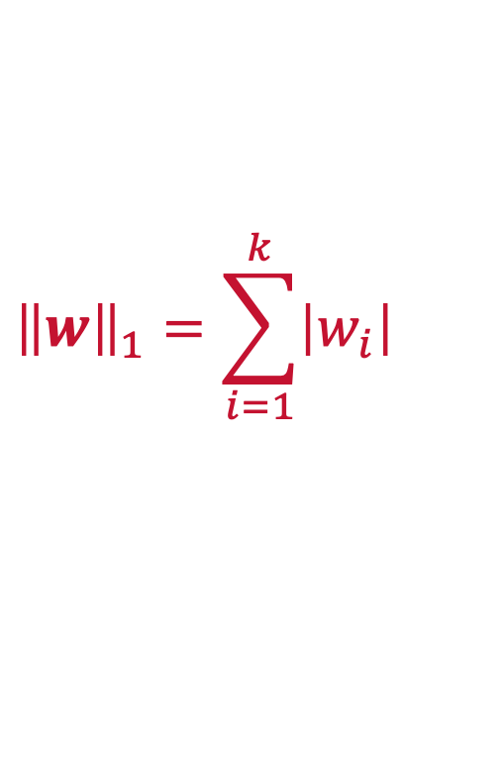
L₁ Norm
Tends to make weights zero
For a weight vector:
The L1 norm is defined as:
$$w= \left[\begin{matrix}w_{1} \\ w_{2} \\ ⋮ \\ w_{k}\end{matrix}\right]$$
$${\left\|w\right\|}_{1}=\sum_{i=1}^{k}{\left|w_{i}\right|}$$

Slide 28
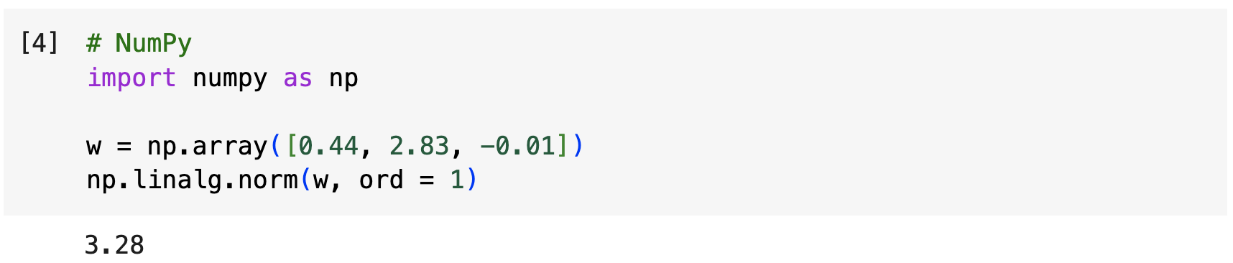
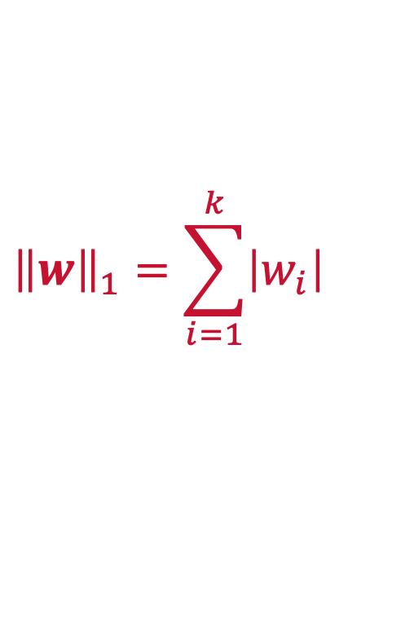
L₁ Norm
$$w= \left[\begin{matrix}0.44 \\ 2.83 \\ −0.01\end{matrix}\right]$$
$${\left\|w\right\|}_{1}=\sum_{i=1}^{k}{\left|w_{i}\right|}$$

Slide 29
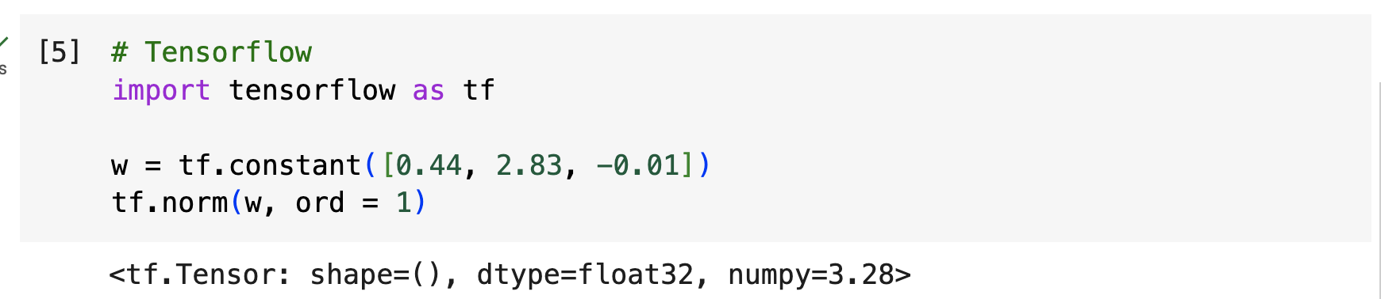
L₁ Norm
$$w= \left[\begin{matrix}0.44 \\ 2.83 \\ −0.01\end{matrix}\right]$$
$${\left\|w\right\|}_{1}=\sum_{i=1}^{k}{\left|w_{i}\right|}$$

Slide 30
Python
Notes:
Guidelines
Use a title slide at the beginning of your presentation. There are 9 variations of title slides to choose from.
If you will have a series of slideshows, we recommend using the same style of title slide for each presentation.
Keep your title to no more than 2 lines.
Do not change the font style or font size of the title or subtitle.

Slide 31
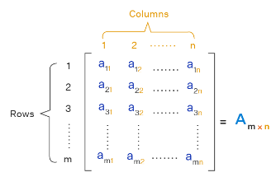
Matrices
A matrix is a rectangular array of numbers (called elements) arranged into rows and columns.

Slide 32
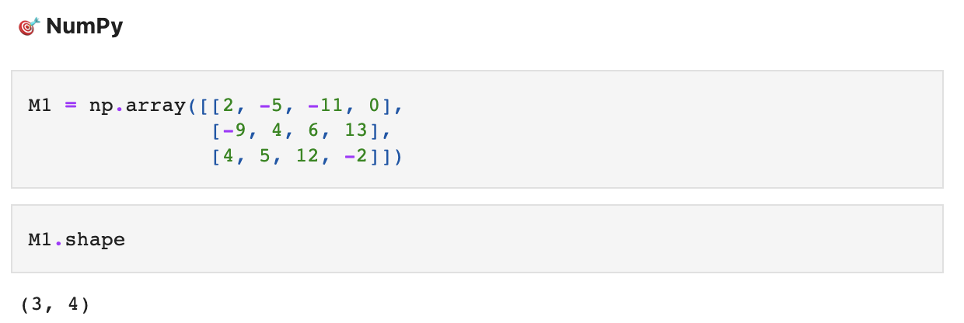
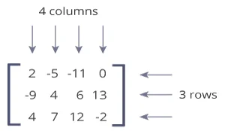
Matrices
A matrix is a rectangular array of numbers (called elements) arranged into rows and columns.

Slide 33
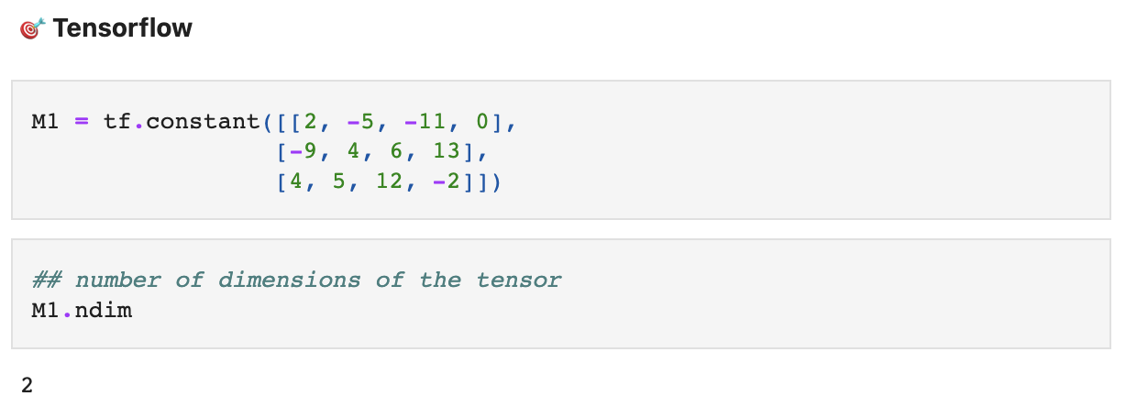
Matrices
A matrix is a rectangular array of numbers (called elements) arranged into rows and columns.

Slide 34
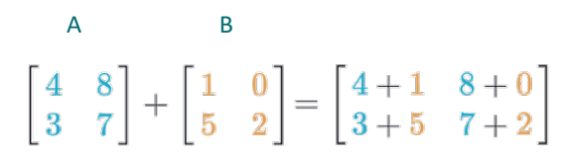
Matrix Addition / Subtraction
You can add two matrices as long as they have the same dimensions.

Slide 35
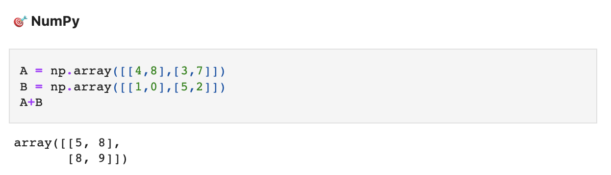
Matrix Addition / Subtraction
You can add two matrices as long as they have the same dimensions

Slide 36
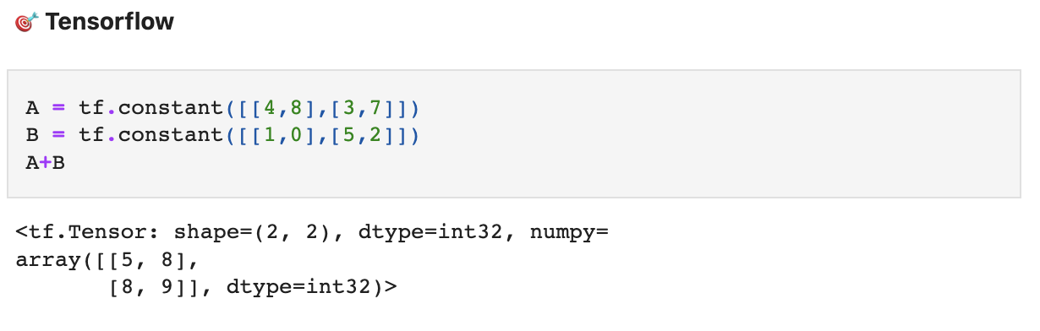
Matrix Addition / Subtraction
You can add two matrices as long as they have the same dimensions

Slide 37
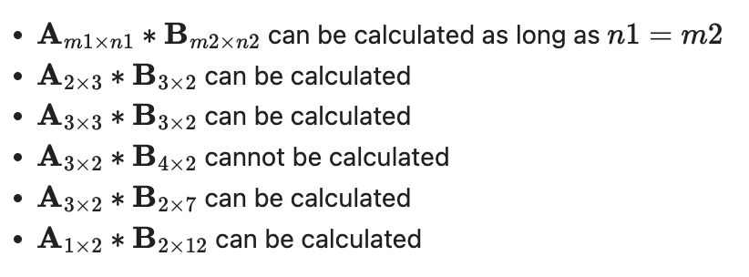
Matrix Multiplication
A matrix can be multiplied by any other matrix that has the same number of rows as the first has columns (conformable).
In other words, Inner Dimensions must match

Slide 38
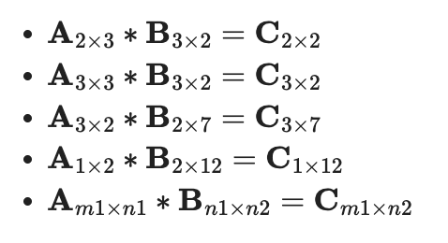
Matrix Multiplication
A matrix can be multiplied by any other matrix that has the same number of rows as the first has columns (conformable).
In other words, Inner Dimensions must match
Resulting matrix have outer dimensions

Slide 39
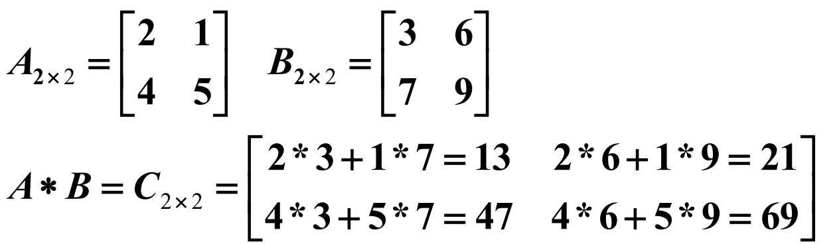
Matrix Multiplication
A matrix can be multiplied by any other matrix that has the same number of rows as the first has columns (conformable).
In other words, Inner Dimensions must match
Resulting matrix have outer dimensions

Slide 40
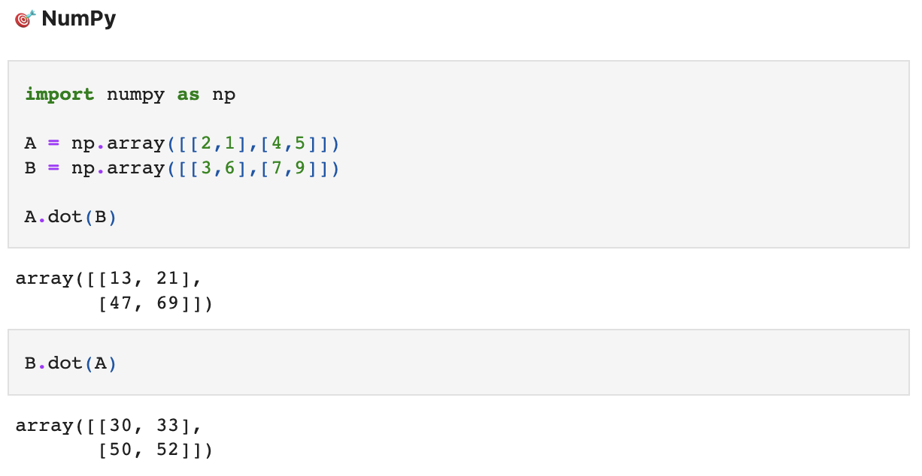
Matrix Multiplication

Slide 41
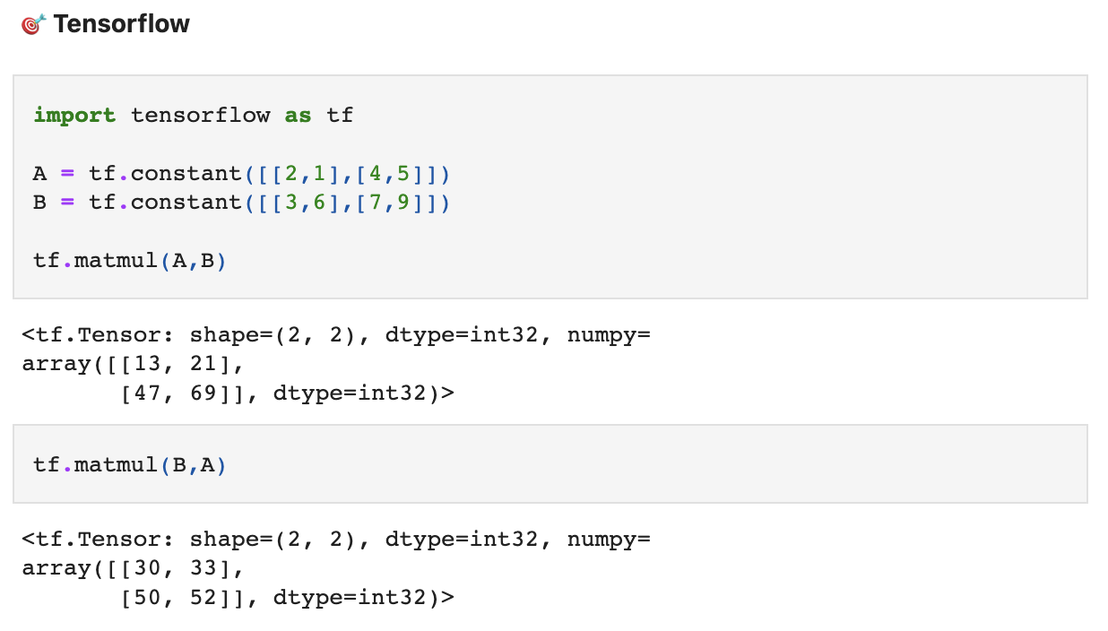
Matrix Multiplication

Slide 42
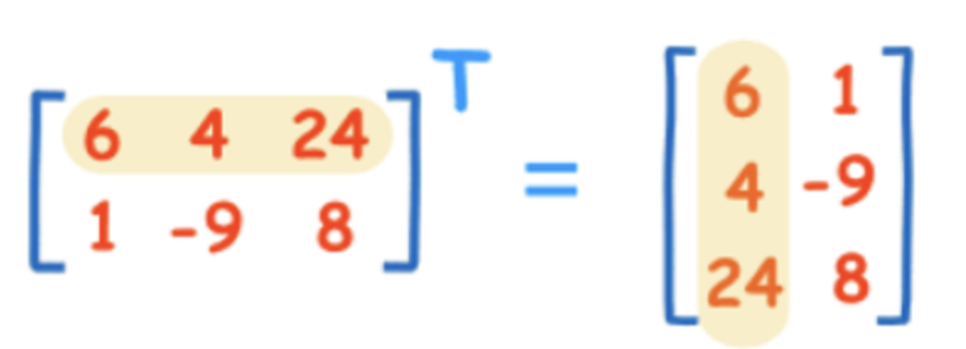
Matrix Transpose
Is a matrix that is obtained by interchanging the rows and columns of the matrix

Slide 43

Matrix Transpose

Slide 44

Matrix Transpose

Slide 45


Identity Matrix
Is a matrix of order $n×n$ such that each main diagonal element is equal to 1

Slide 46


Identity Matrix
Matrix of order $n×n$ such that each main diagonal element is equal to 1

Slide 47

Identity Matrix
Matrix of order $n×n$ such that each main diagonal element is equal to 1

Slide 48

Linear Dependence
A matrix is linearly dependent if at least one row (or one column) is a linear combination of the others

Slide 49
Linear Dependence
A matrix is linearly dependent if at least one row (or one column) is a linear combination of the others
2 X

Slide 50
Linear Dependence
The rank of a matrix is the number of columns that are independent
2 X

Slide 51

Linear Dependence

Slide 52

Linear Dependence

Slide 53



Matrix Inverse
is a matrix $A^{−1}$ such that ${AA}^{−1}=I,$where I is the identity matrix.

Slide 54

Matrix Inverse

Slide 55

Matrix Inverse

Slide 56

Sparse vs Dense Matrices
a sparse matrix is a matrix in which most of the elements are zero

Slide 57

Sparse vs Dense Matrices

Slide 58

Sparse vs Dense Matrices

Slide 59
Python
Notes:
Guidelines
Use a title slide at the beginning of your presentation. There are 9 variations of title slides to choose from.
If you will have a series of slideshows, we recommend using the same style of title slide for each presentation.
Keep your title to no more than 2 lines.
Do not change the font style or font size of the title or subtitle.

Slide 60

Tensors
A Tensor is a generalization of Vectors and Matrices to higher dimensions

Slide 61

Tensors

Slide 62

Tensors

Slide 63
Python
Notes:
Guidelines
Use a title slide at the beginning of your presentation. There are 9 variations of title slides to choose from.
If you will have a series of slideshows, we recommend using the same style of title slide for each presentation.
Keep your title to no more than 2 lines.
Do not change the font style or font size of the title or subtitle.

